Slide 1
What is Encapsulation
Encapsulation is all about wrapping variables and methods in one single unit. Encapsulation is also known as data hiding
Your class is designed as a black-box. You have access to several methods from outside (classes) and a return type for each of those methods.
Why is Encapsulation
Because, when you design your class you may (and you should) make your variables hidden from other classes and provide methods to manipulate the data instead.
How to “Encapsulation”
Declare the variables of a class as private.
Provide public setter and getter methods to modify and view the variables values.

Slide 2
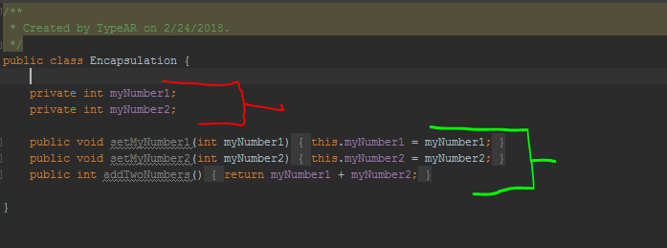


Example
Above example demonstrates encapsulation in Java.
The Encapsulation class has two fields – myNumber1 and myNumber1. Both are declared as private, meaning they can not be accessed directly outside the class.
The setter methods : setMyNumber1, setMyNumber2, addTwoNumbers. are declared public. Those methods are exposed to “outsiders” and can be used to change and retrieve data from the Encapsulation object.
This is what encapsulation does – it hides the implementation and gives us the values we want

